Slide 1

Copyrighted in its entirety, Ernest R. Cadotte, 2018
Notes:
The PowerPoint theme (background, font, and colors) can be changed using the Design tab above

Slide 2

Team Name

Slide 3
Team Members
Member Name Primary role Secondary role
Kush Jain President- Overall Leadership Accounting & Finance
Pallav Pathak VP – Manufacturing VP – Accounting & Finance
Reet Veerwani VP – Human Resources VP – Marketing
Tanishka Khaire VP – Accounting & Finance VP – Business Analytics
Yashraj Madhrani VP – Marketing VP – Sales Management
Shubham Kumar VP – Business Analytics VP – Sales Management

Slide 4

Mission Statement and Objectives
Mission Statement
Our mission is to ensure that our customers have access to the best bikes and accessories, to help them to get the most out of their cycling experience. We want to create an environment where everyone can feel comfortable and safe while biking, and we will always strive to provide the best products and advice that we can.
Objectives
We are committed to offering a comprehensive range of bikes and accessories that are designed to help people get the most out of their biking experience. We will strive to provide our customers with the best quality products, and ensure that they are always able to get the support and advice they need.

Slide 5

Target Segments
1 – SPEED
2 - RECREATION
3 - MOUNTAIN

Slide 6
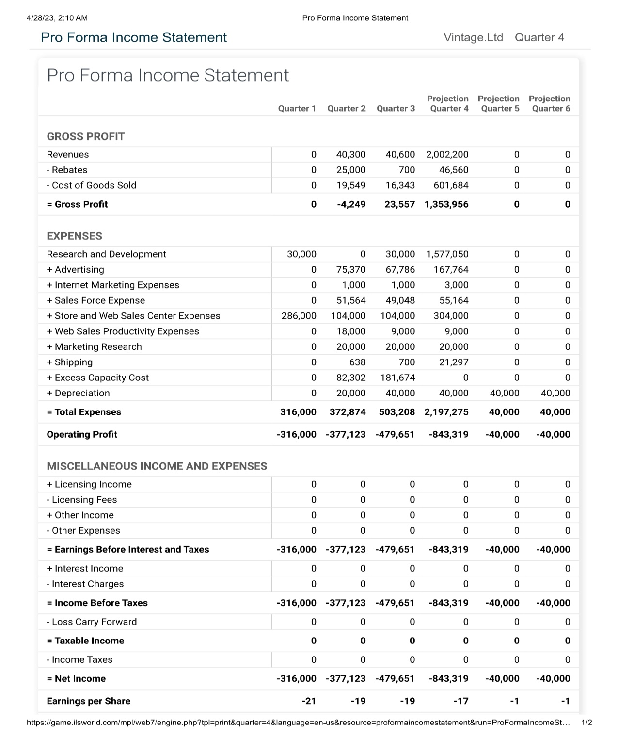
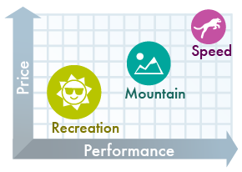
Past Financial Performance
Notes:
The income statement can be exported from the game in Quarter 4 (located under Performance Report – Income Statement). Use the export button at the at the top right of the workspace to open Excel, then copy and paste to the slide above

Slide 7
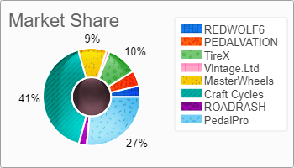
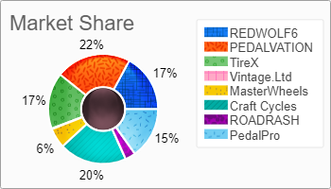
Past Market Performance
Notes:
The image above can be exported from the game software by navigating back to Quarter 3 (located under Performance Report – Market Share). Use the save button to save the image to your PC, then add it to the slide above.

Slide 8
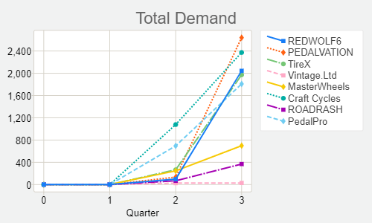
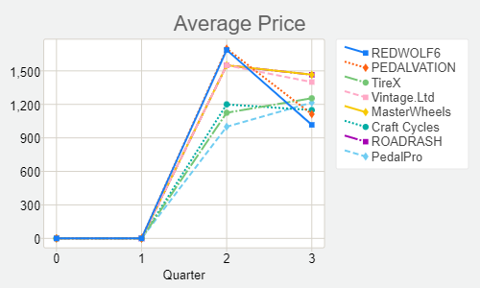
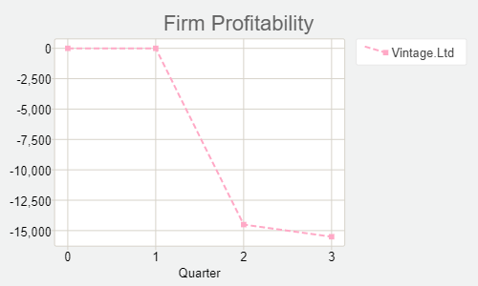
Past Performance
Notes:
The images above can be found in Quarter, under Performance Report – Strategic Graphs. Click on the individual graphs to view bar graphs as well. You can choose several graphs that highlight past performance from this section to include on the slide above.

Slide 9
Competitor Analysis
 | RoadRash | Redwolf 6
Target Markets | Rec, Mtn
Total Demand | 68 | 97
Average Price | 1550 | 1687.5
Total Regional Inserts | 14 | 18
Number of Web Pages | 3 | 3
Sales Offices | Newyork Amsterdam | Newyork Amsterdam
Sales Force Compensation | 19824 | 22621
Sales Force Productivity | 64% | 75%
Worker Compensation | 63% | 75%
Worker Productivity | 63% | 75%
Notes:
The table above can be filled out with information on your competitors. This information can all be found under the Marketing Research menu item in the game. Look under Marketing Research – Competitors’ Profiles for a summary report of the market. Insert or Delete rows/columns by right-clicking on the table or use the Table Tools tab.

Slide 10
SWOT Analysis
Strengths
Weaknesses
Opportunities
Threats
Notes:
The tables above can be used to document a SWOT analysis for your company.

Slide 11

Strategies
Product development
Good Sales compensation
Good worker’s compensation
Proper Manufacturing
Effective Advertising
Market Penetration
Notes:
Briefly outline your strategies for the future on the slide above.

Slide 12
Brand Management and Pricing Plans
Notes:
The slide above showcases your brand management and pricing plans for the future. Customize this slide to portray your future plans for brands. The pricing table data can be edited by right-clicking on the table and selecting Edit Data.

Slide 13
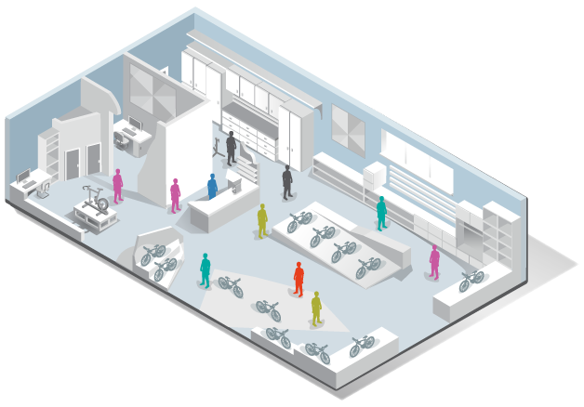
Store and Sales Person Plans
 | Quarter 2 | Quarter 3 | Quarter 4
Open Stores | 0 |  | 3
Number of Sales People | 0 | 9 | 10
Unit Demand per Office Sales Person | 68 | 170 | 310
Projected Demand | 354 | 870 | 1690
Notes:
Update the table above to reflect your store and sales person plans for the future, as well as your projected demand.

Slide 14

Financial Strategy
Covering Expenses by increasing sales
A Better Pricing Model
More Budget on R & D so that our bikes can be more efficient
Make our EPS strong & Positive
Hiring staff for better sales

Slide 15
Projected Return on Investment
Total Investment Requested | Per Share | Number of Shares | Return on Investment
$2,500,000 | $120 | 20833 | 567%

